Slide 1




TESLA Forecasting Analysis
Model Y
Name: Andrea Astudillo

Slide 2
Objectives
Which forecast method to choose for the next year sales using Tesla’s historical data?
Understand the market demand
Optimize the production levels and inventory management

Slide 3

Data Background
Model Y is an electric crossover vehicle introduced by Tesla, Inc
Production began early 2020
Production takes place in multiple factories worldwide:
Shanghai, China
Berlin, Germany
First deliveries took place in mid 2020
Shares 75% of its components with Model 3, but offering more cargo space
It was anticipated that Model Y would outsell Model 3
Key Features:
The dataset is based on monthly sales units
From July 202 until December 2023

Slide 4
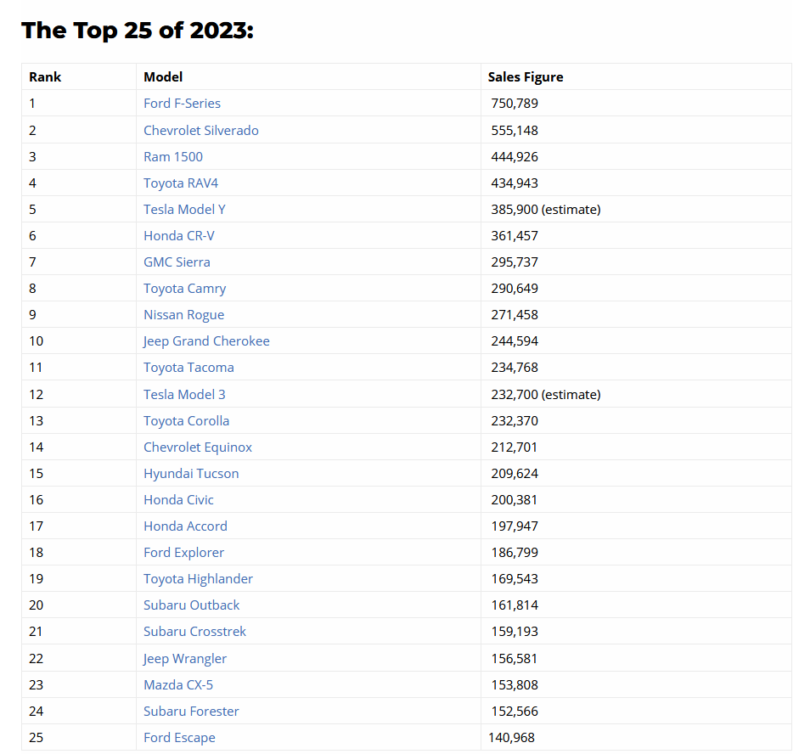

In 2023 Tesla Model Y was in the top 5 most selling cars in the US
Model Y’s sales were higher than model 3

Slide 5
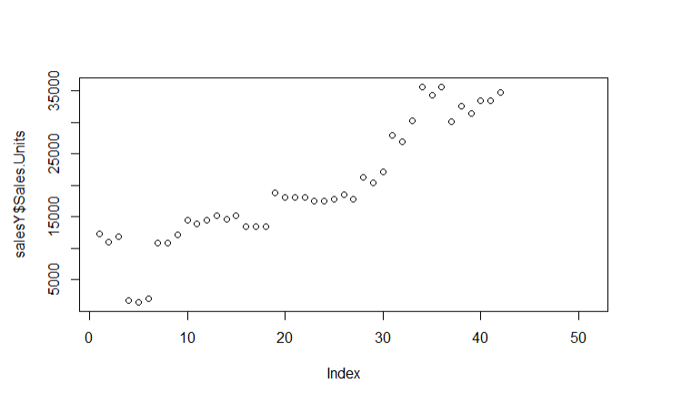
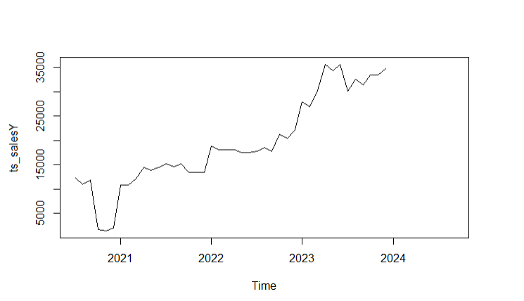
Insights from Exploratory Data Analysis
Data Plot
Initial Period:
In October, November and December of 2020 sales drop significantly
Growth Period:
In 2021, sales started to increase
Sharpe Increase:
End of 2023, we can observe a peak in sales
Time Series Plot

Slide 6
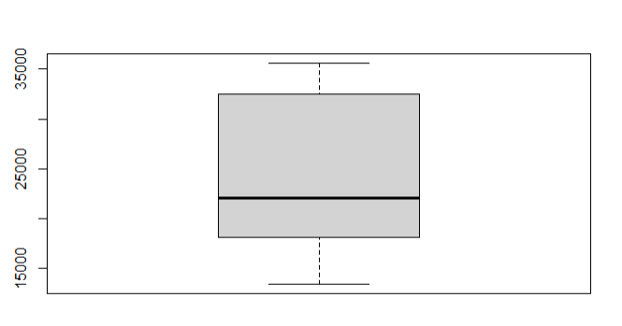
Continue: Box Plot
The median is lower than the mean
Distribution is right skewed
No outliers in the box plot
Implies that the data tends to underestimate in certain cases
Predicting lower sales than the actual outcomes
Risks for understocking – not meeting the demand

Slide 7
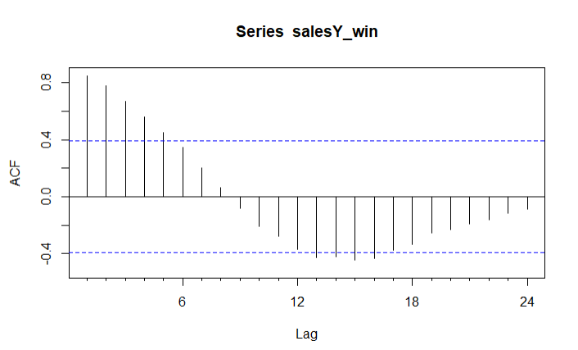
Continue: ACF Plot
Lags crossing the confidence intervals
Not capturing unexpected behaviors in the data set.
Notes:
Lagged variables are often used to model relationships between past values and current outcomes

Slide 8
Accuracy Measure
Mean Absolute Percentage Error (MAPE)
Explains how much of the forecast deviates from the actual sales in percentage terms
Guide decisions related to inventory planning
It can give greater penalty to large errors
Ensures the model not only fits the historical data
BUT
Reliable in predicting significant fluctuations

Slide 9
Insights from the different Forecasting Methods
and
Residual Analysis

Slide 10
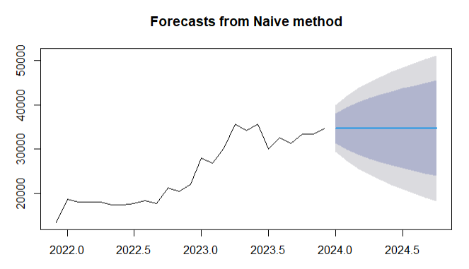
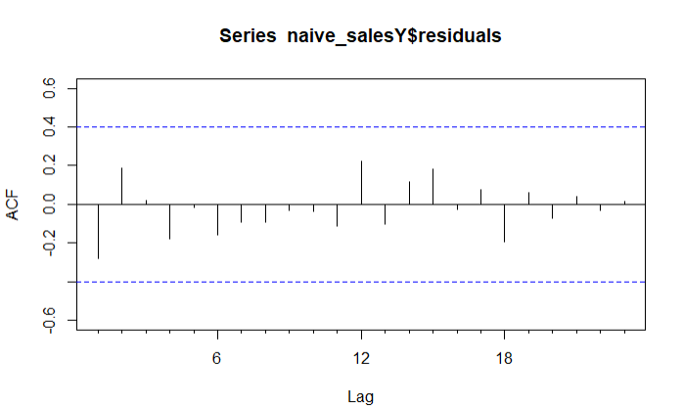
Naïve Method
Naïve Method:
It involves using the last observed value as the next forecast value
Assumes no trend, seasonality or any fluctuations
Residuals:
In the Acf plot we can observe that all the values at the lags are close to the zero.
Indicating no systematic pattern.

Slide 11
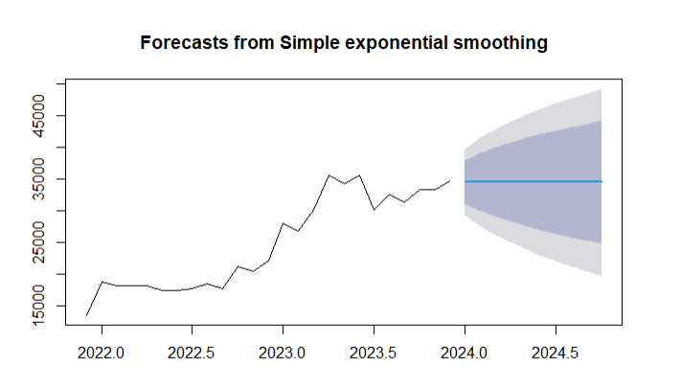
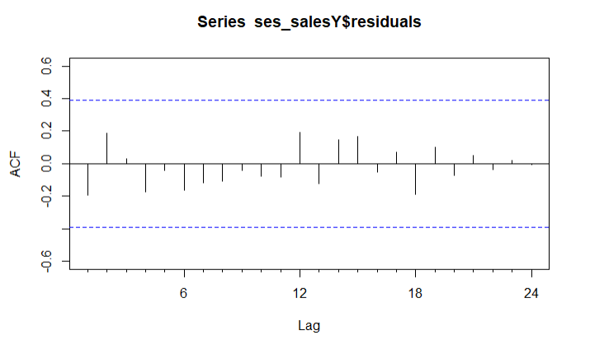
Simple Exponential Smoothing
SES Method:
It calculates the next forecast value as a weighted average of the actual value.
Alpha = 0.8758
gives more weight to recent values
Residuals:
In the Acf plot we can observe that all the values at the lags are close to the zero.
Indicating no systematic pattern.

Slide 12
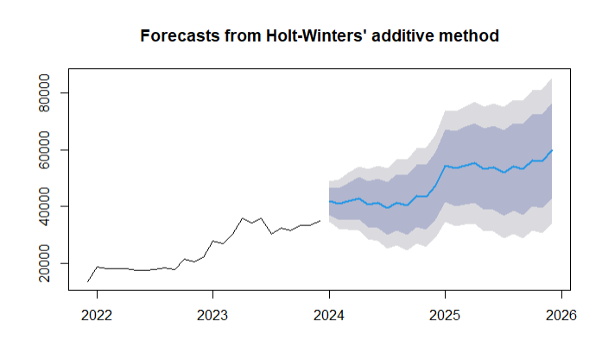
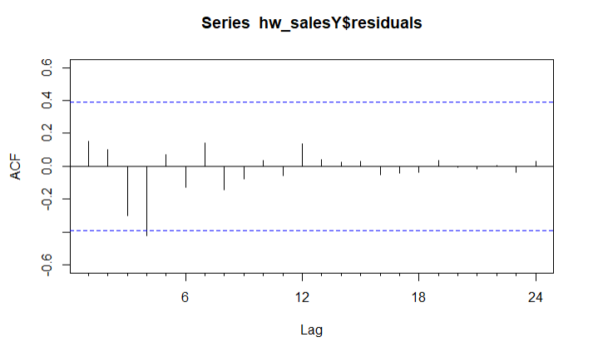
Holt-winters
Holt-Winters Additive Method:
It is effective when seasonality fluctuations are constant over time
Alpha = .0.7158
gives more weight to recent values
Beta = 1e-04
assumes the trend component remains constant over time
Gamma = 0.2842
gives more weight to past seasonal values
Residuals:
In the Acf plot we can observe that one value slightly cross the confidence interval
Suggesting the model has not fully captured all patterns
Improvement might be need due to an unexpected event or outliers.

Slide 13
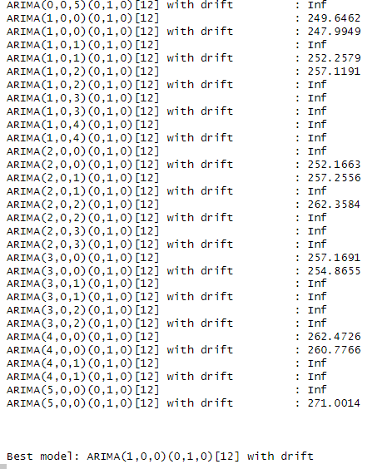
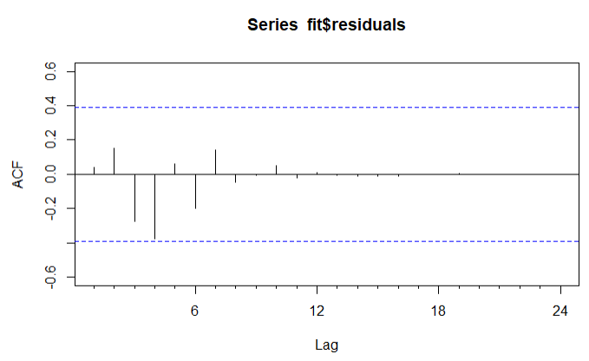
ARIMA
Arima Method:
Combines the autoregression (AR), differencing (I), and moving averages (MA)
Capture patterns and correlations between sales and future sales taking both into account
Handle periods of sudden increases or drops.
ARIMA(1,0,0)(0,1,0)[12]
AR(1): uses previous month’s sales to forecast the next one
D(1): removes patterns in the data
Residuals:
In the Acf plot we can observe that all the values at the lags are close to the zero.
Indicating no systematic pattern.

Slide 14
Prediction and Accuracy Summary from different forecast methods

Slide 15
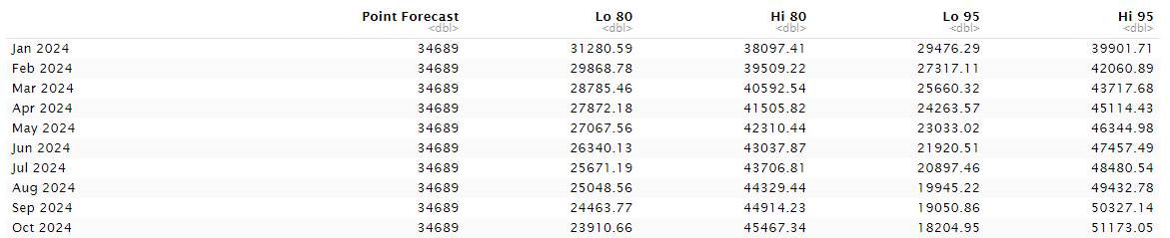
Naïve Method
Naïve Method Predictions:
Single best estimate = 34,689 sales units without any uncertainty
Confidence interval 80% and 95% indicates a range of values when there is uncertainty
The wider the interval, the more uncertainty.
Accuracy:
MAPE = 7.193973

Slide 16
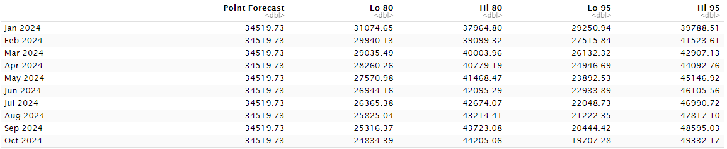
Simple Exponential Smoothing
Simple Exponential Smoothing Predictions:
Single best estimate = 34,519 sales units without any uncertainty
Confidence interval 80% and 95% indicates a range of values when there is uncertainty
The wider the interval, the more uncertainty.
Accuracy:
MAPE = 6.588294
Performing better than Naïve Method

Slide 17
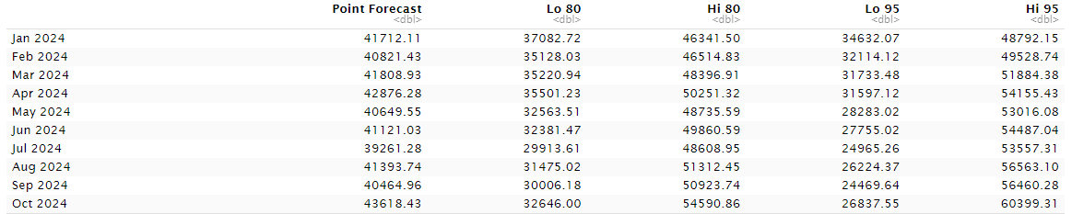
Holt-winters
Holt – Winters Predictions:
Best estimate range = 39,261 to 43,618 sales units without any uncertainty
Confidence interval 80% and 95% indicates a range of values when there is uncertainty
The wider the interval, the more uncertainty.
Accuracy:
MAPE = 4.794672
Performing better than Naïve Method and Simple Exponential Smoothing

Slide 18
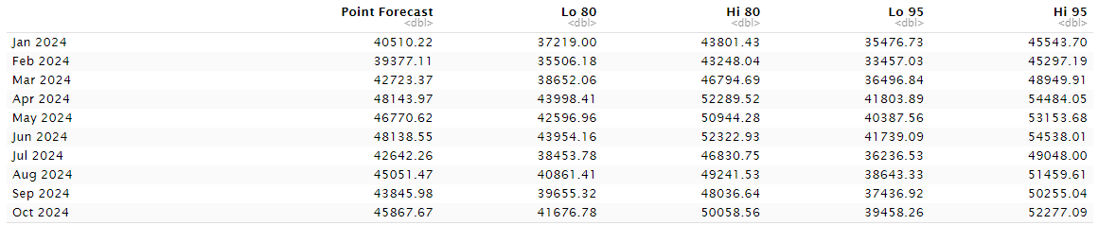
ARIMA
Arima Predictions:
Best estimate range = 39,377 to 48,138 sales units without any uncertainty
Confidence interval 80% and 95% indicates a range of values when there is uncertainty
The wider the interval, the more uncertainty.
Accuracy:
MAPE = 3.225937
Performing better than all the other forecast methods.

Slide 19

decision based on the analysis
Arima has the smallest mean absolute error
Closer to the actual values
Residual plot, no values have crossed the confidence interval

Slide 20

ideas to improve the forecast
Incorporate events such as holidays or promotions that can impact the sales
Example: peak at the end of 2023
This data can be excluded or adjusted from the analysis

